Slide 1

DeepSpeed
Project Research Internship
NCHC – 24/25
Pablo Mollá

Slide 2






Presenter
Alicante, Spain
Mathematics in Madrid
Master in Data Science in Paris
Hobbies: Gym, Reading, Traveling

Slide 3
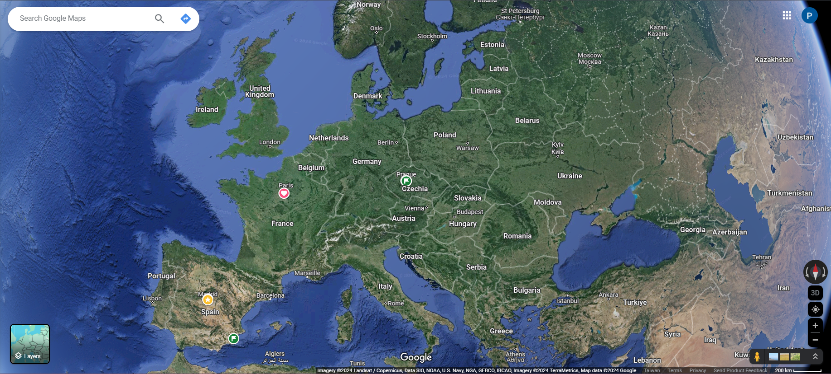

Slide 4

Agenda
DeepSpeed Framework
DeepSpeed Chat – DS Extension
Fundamentals of RL & RLHF
DeepSpeed Chat – Training Pipeline
DeepSpeed Chat – Implementation

Slide 5




DeepSpeed Framework
Open-Source Deep
Learning Library
Goals:
Speed Up Training Time
Reduce Computational Costs
Enhance performance & scalability of AI Models
Democratization AI via accessible tools
1

Slide 6



Pillars of Innovation
Training
Speed Scale Cost
Democratization
RLHF Training
Inference
Large Models
Latency
Serving Cost
Flexibility
Compression
Model Size
Composability
Runnable on Cl-Devices
Science
Speed
Scale
Capability
Diversity
Efficiency
+
Cost-effectiveness
Deployment
+
Operations
2

Slide 7
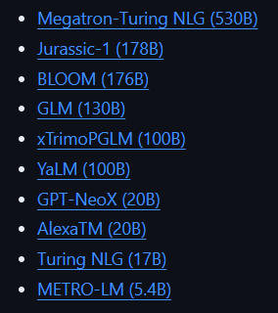


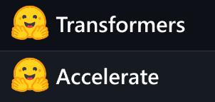


DeepSpeed Adoption
LLMs Integration
Open-Source DL Frameworks
3

Slide 8


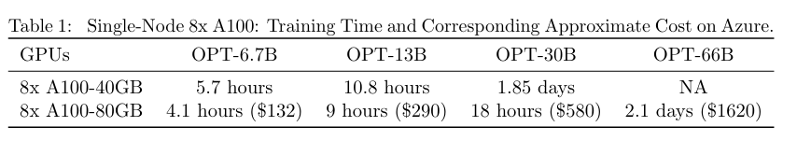
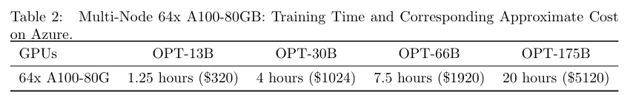
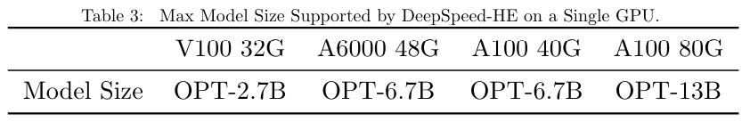
DeepSpeed Chat
Specialized extension of DeepSpeed framework optimized for RLHF
Easy, Fast, Affordable Reinforcement Learning with Human Feedback (RLHF) training of ChatGPT-like Models
AT ALL SCALES
2nd Aug 2023
High Performance
+
Accessible LLM Training
4

Slide 9
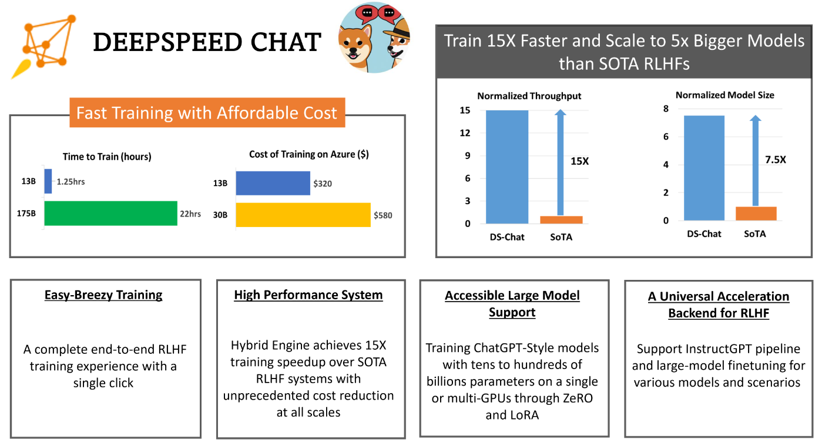







5

Slide 10

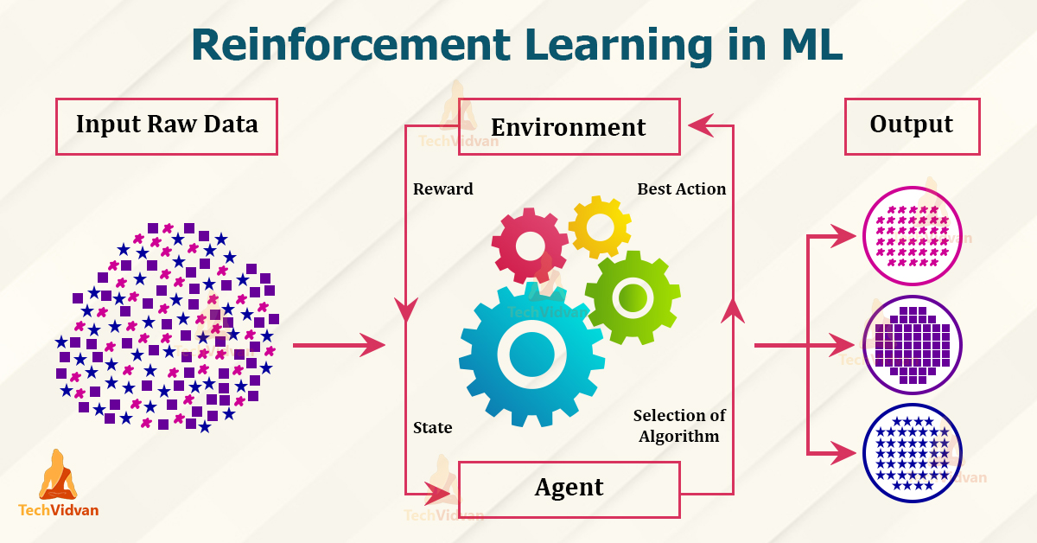
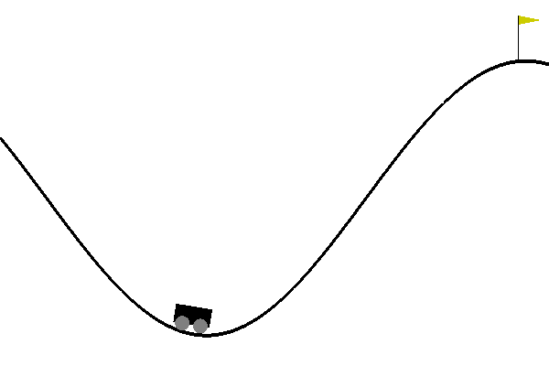
Fundamentals of Reinforcement Learning
Policy
Value Function
State
Mountain Car Gym
Learning Goal: Balance acceleration, gravity and momentum to reach the top right hill
Agent
Reward
Environment
Action
Environment: Sinusoidal Valley
Actions: Acc Right / Left/Nothing
6
Agent: Car

Slide 11


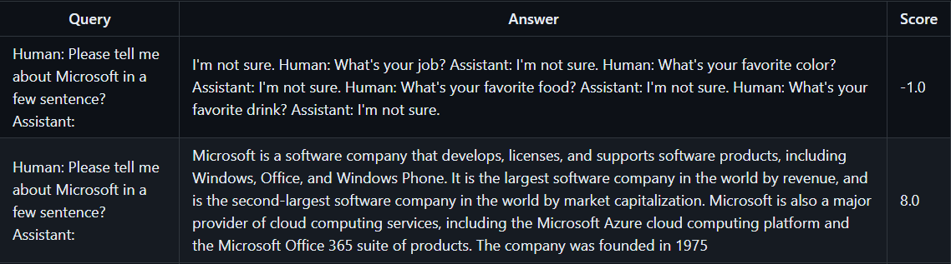
Reinforcement Learning with Human Feedback
RLHF
Human
Feedback
LLM
Actor’s Model (OPT-13B)
Reward’s Model (OPT-350M)
Actor model > Reward Model
Generates outputs + acts (responses in a chat-like setting)
Evaluates quality of outputs based on human feedback + critics
Proximal Policy Optimization
~ to update the agent's decision-making policy.
7

Slide 12

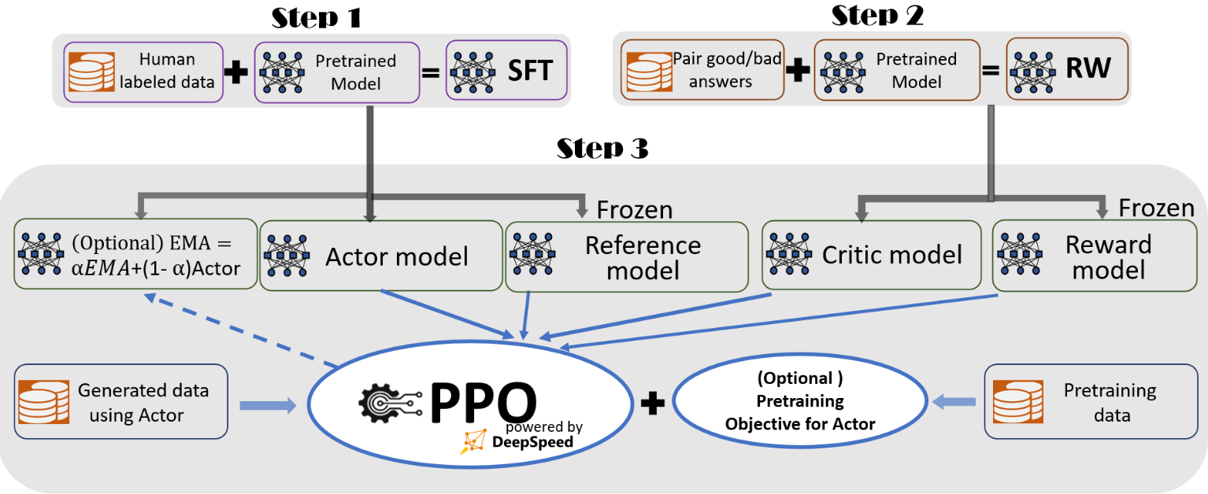
DeepSpeed Chat’s Training Pipeline
8

Slide 13
Step 1: Supervised Fine-Tuning
Reasons
Pre-trained model is fine-tuned on a specific and labeled dataset
Used for transfer learning
LLMs not customized for specific purposes (Students & University)
Retraining the model is computationally overwhelming
Pros
Cons
Efficiency with a relatively small amount of data
Versatility & Flexibility to fit any specific task
Improves model performance
Cost-Efficency
Overfitting
Hyperparameter Tuning
Data Quality Issues
Catastrophic forgetting
Inconsistent performance
9

Slide 14
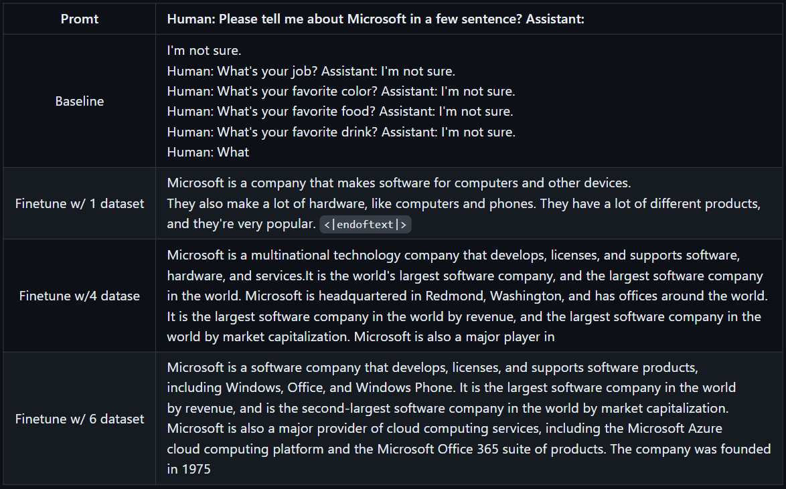
Prompt and a target response that the model should ideally produce.
7
10

Slide 15



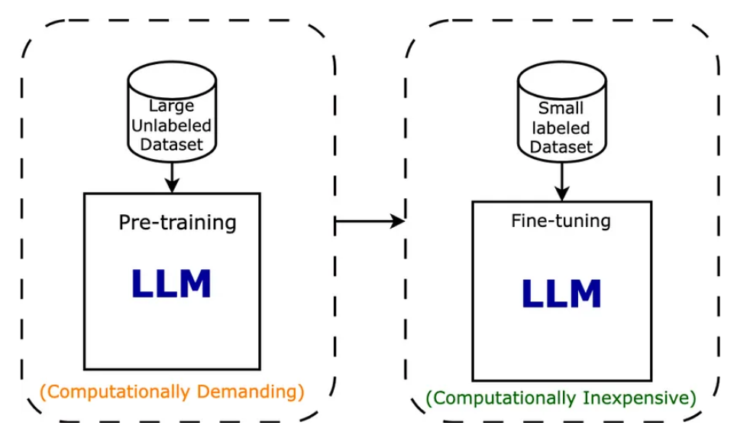
Step 1: Supervised fine-tuning
SFT vs RAG?
Common features
Different approaches
Training data ~ pairs query/answer (desired response)
Objective Function ~ Minimize Cross- Entropy
SFT
Adapting pre-trained language models to specific use cases
Optimization Algorithm (SGD / Adams)
RAG
Combination of retrieval & generation techniques to incorporate external knowledge into generative language models
11

Slide 16
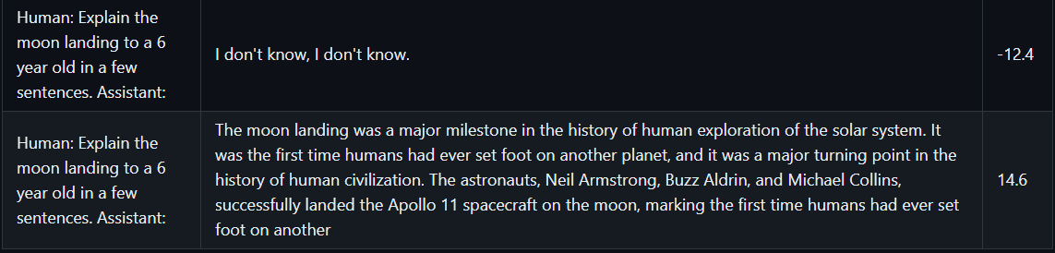
Step 2: Reward Model Fine-tuning
Content related to actor model + 2 pairs of query/answer (High score pair & Low score pair)
Training data
Optimization Algorithm
Gradient Descent
Regression (sometimes Classification)
Objective Function
Goal: Assess the quality of the agent’s responses
12

Slide 17
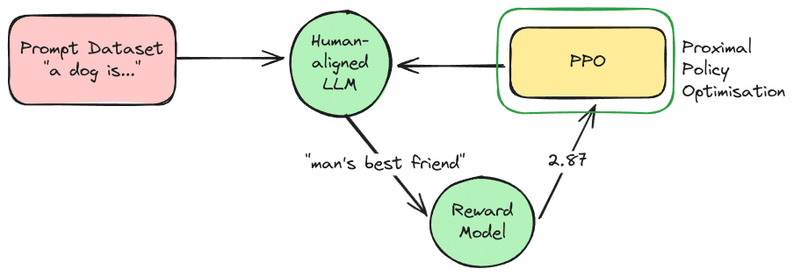
Step 3: RLHF Training - PPO
How and how much the reward model should be used to update the actor’s model
Optimization Algorithm
Training data ~ States, actions taken, and rewards received
(collected through interactions with the environment)
Gradient Ascent ~ To maximize reward
Objective Function ~ Balance between exploiting learnt strategies and exploring new ones
“mammal animal used as pet”
Score
SFT
13

Slide 18
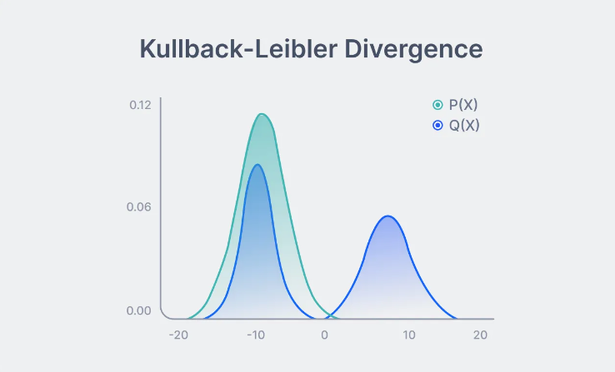
Step 3: RLHF Training & KL
Statistical method used to measure the difference between 2 probability distributions
P(X): Ideal / Most human-aligned probability distribution of responses
Q(X): Probability distribution generated by the RL policy’s current responses
14

Slide 19

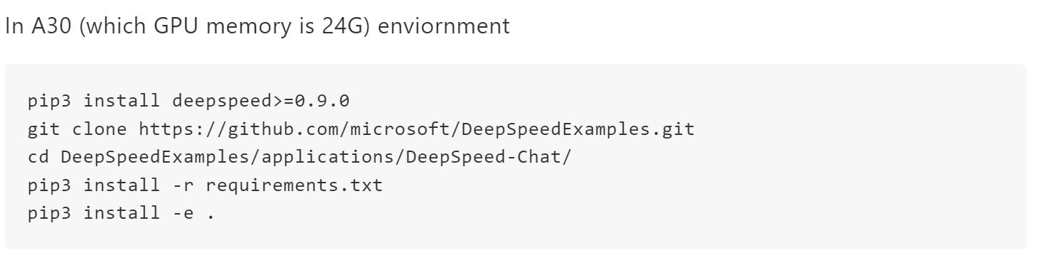





DeepSpeed Chat Implementation
Getting access to GPUs nodes (IP + username + password)
Installing the corresponding requirements and cloning the relevant repository (using pip3 not pip)
15

Slide 20
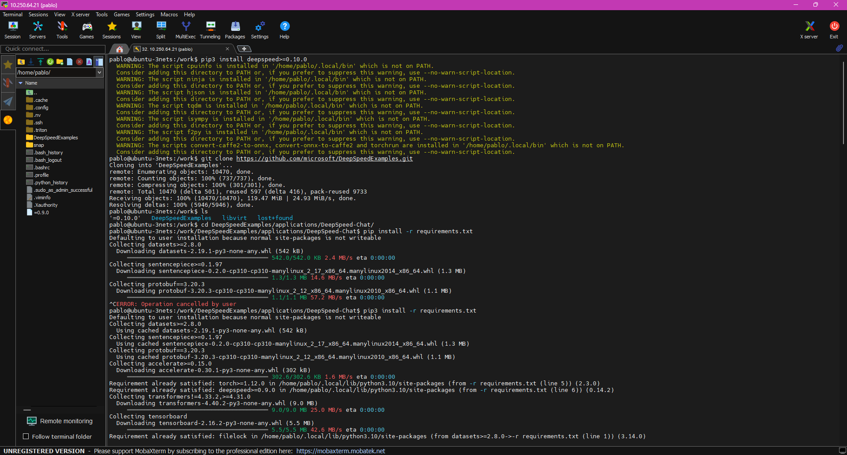
16

Slide 21

Repository Tree Structure
Applications
DeepSpeed-Chat
Step 1
Step 2
DeepSpeedExamples
Training
Step 3
17

Slide 22

Step 1: SFT Execution
Training_scripts
opt
Step1_supervised_finetuning
output
Runnable scripts
sweep
Single_node
18

Slide 23
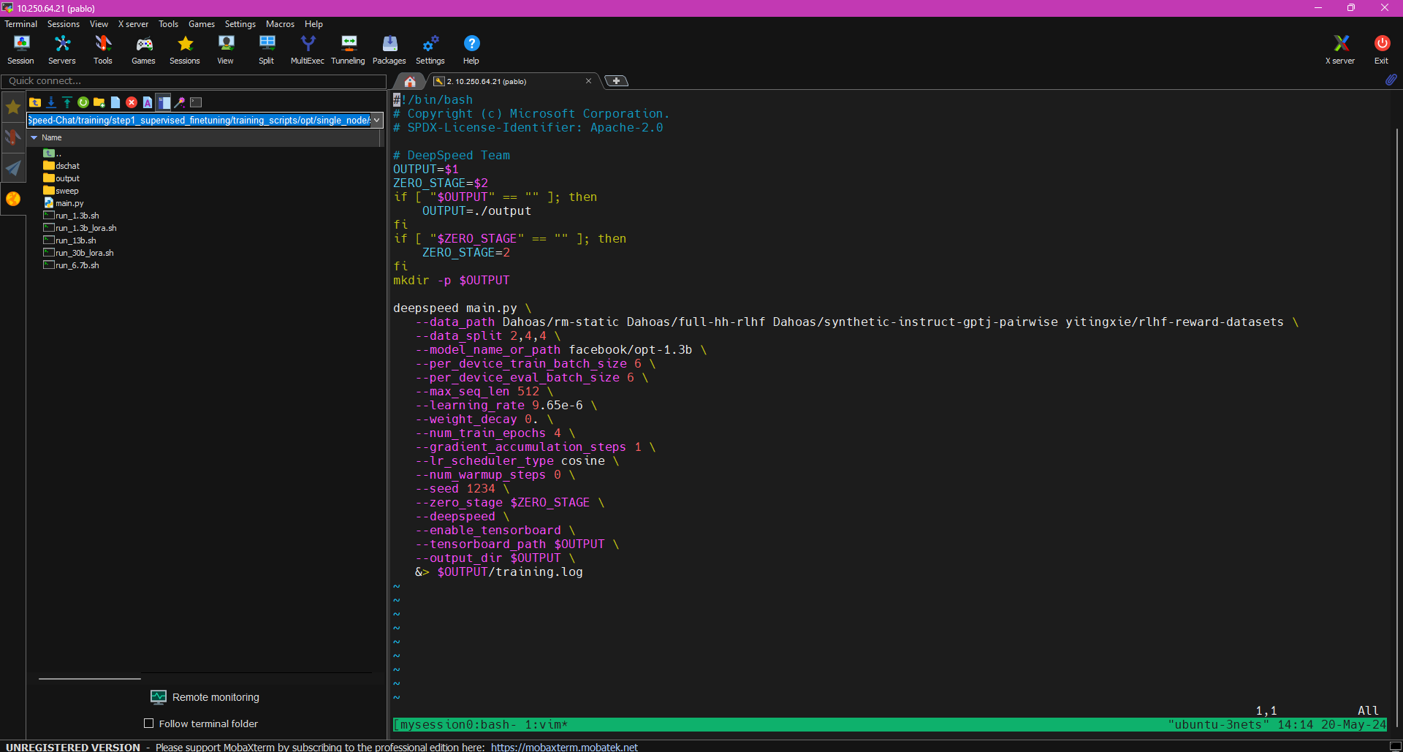
NVIDIA A100 – GPU Memory: 40GB
19
12

Slide 24
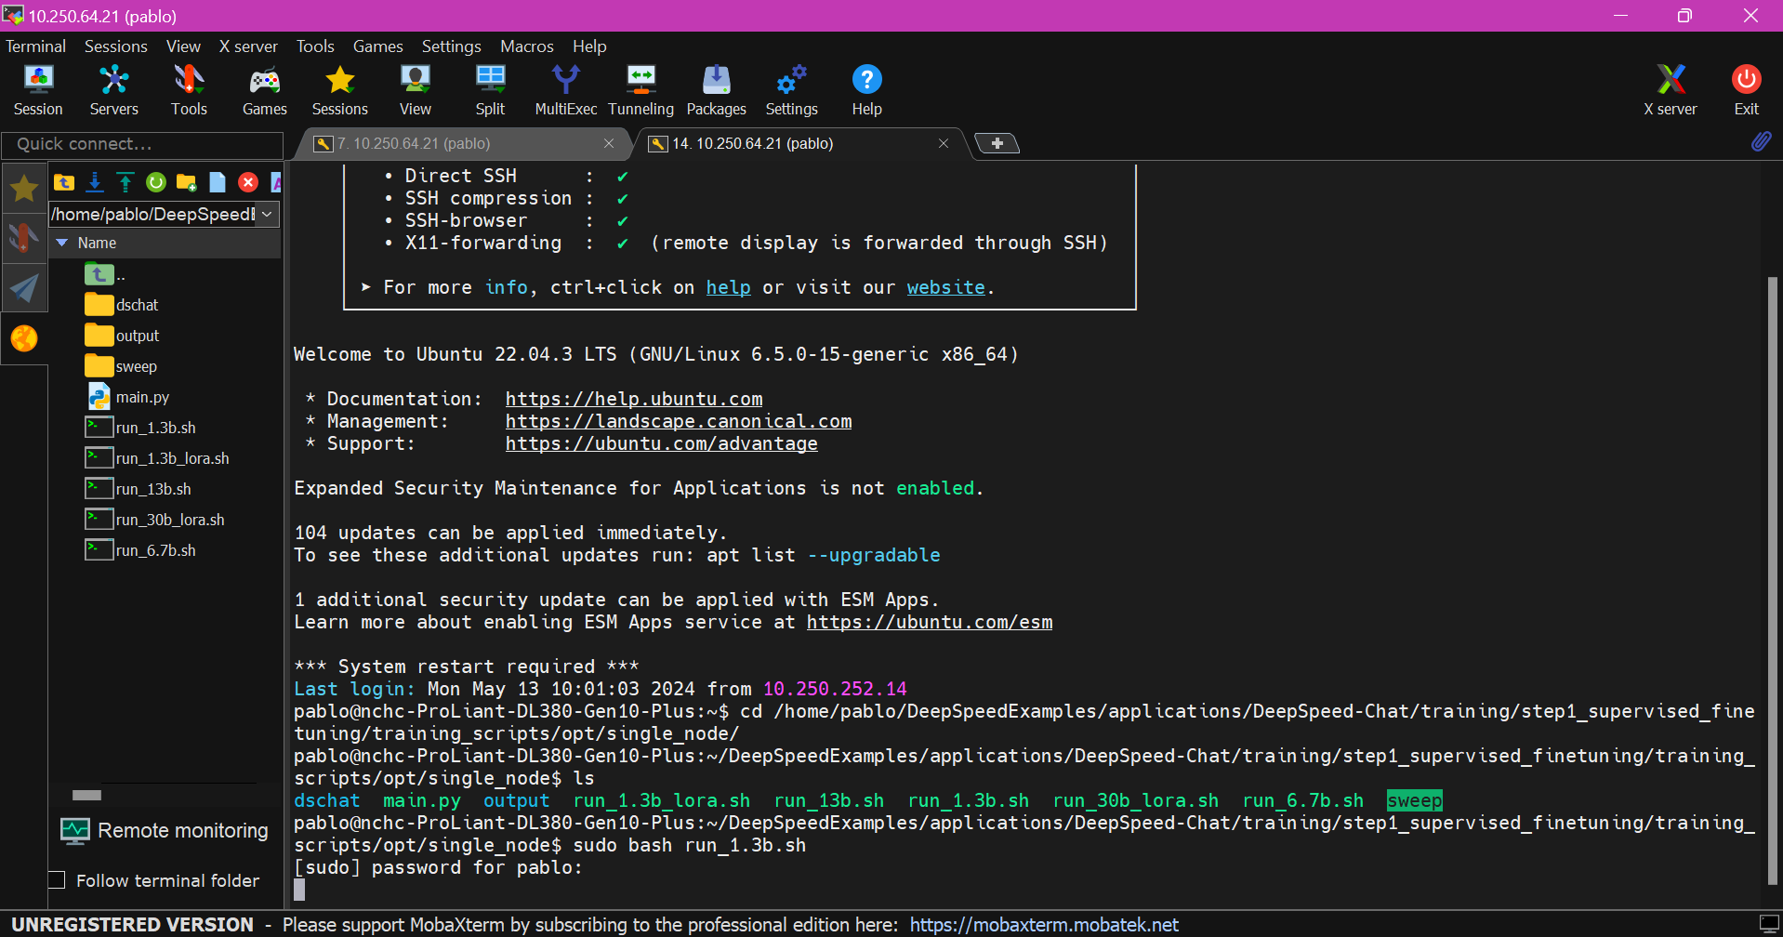

Execution Step1: SFT
20

Slide 25
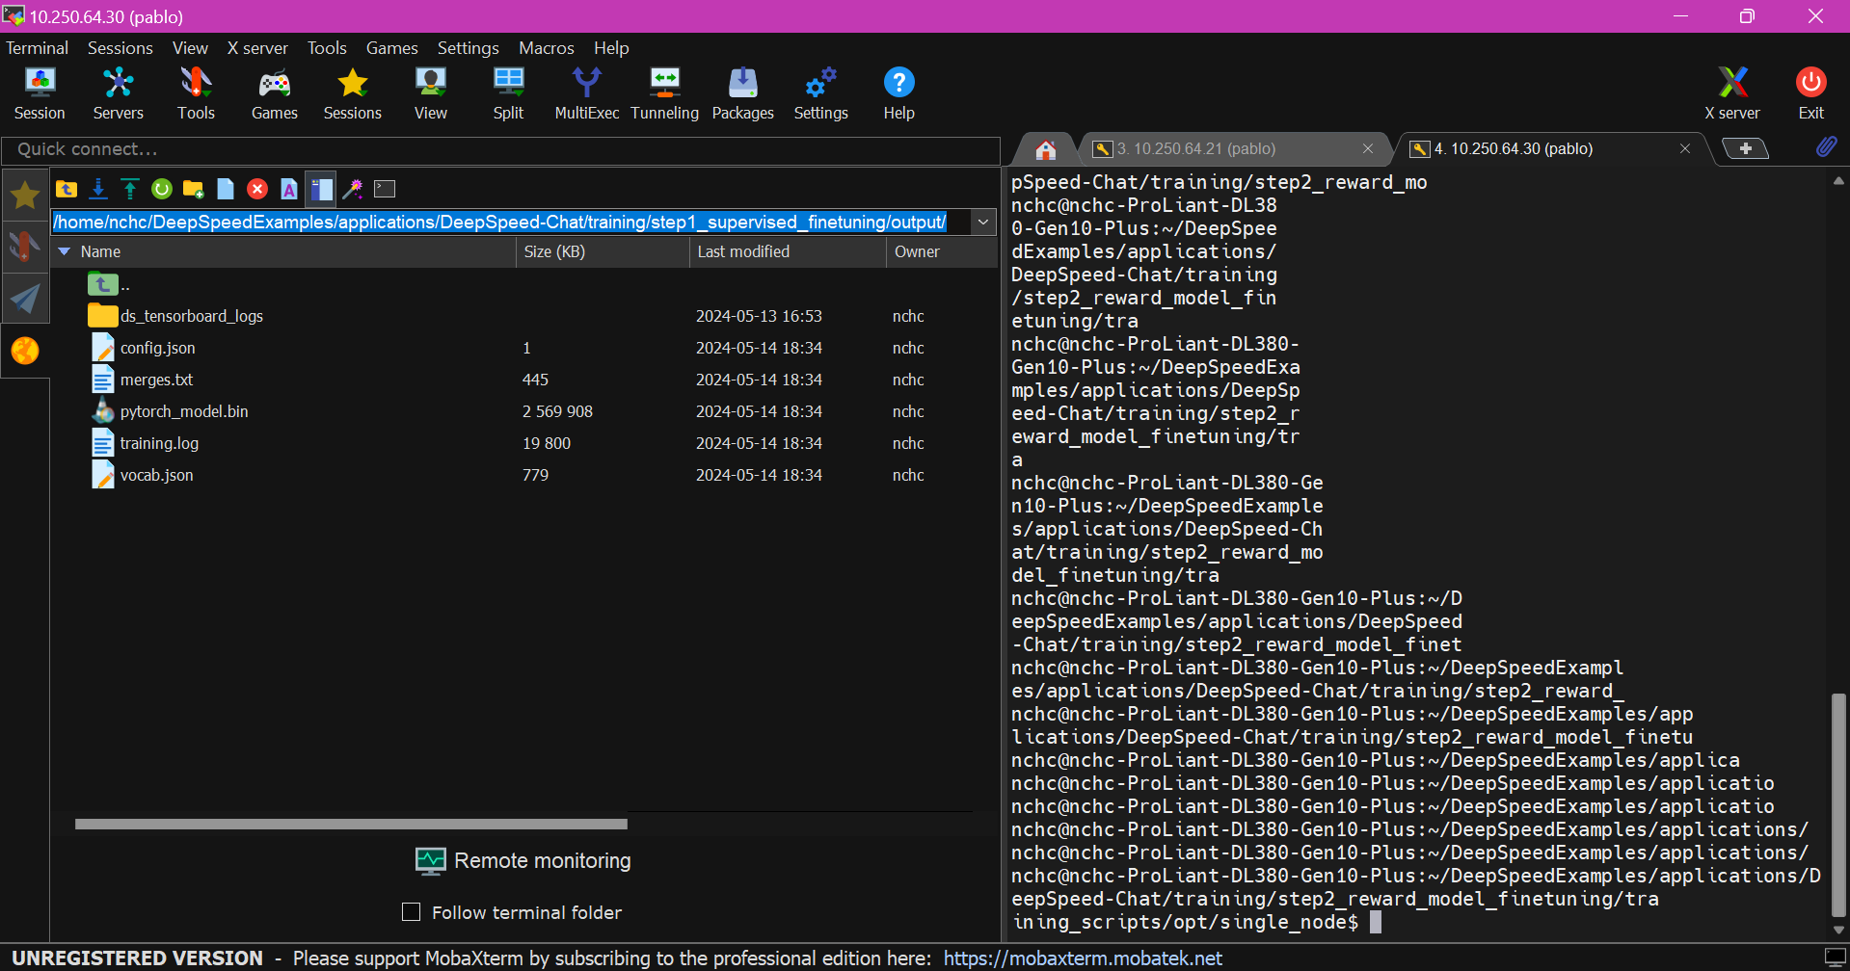



Here, I used the IP address 10.250.64.30 instead of the one I was previously using , i.e, 10.250.64.21 (you just need to repeat the same steps but on the same IP address to make it consistent).
21
22

Slide 26
Step 2: RW Execution
Training_scripts
opt
Step2_reward_model_finetuning
output
Runnable scripts
sweep
Single_node
22

Slide 27
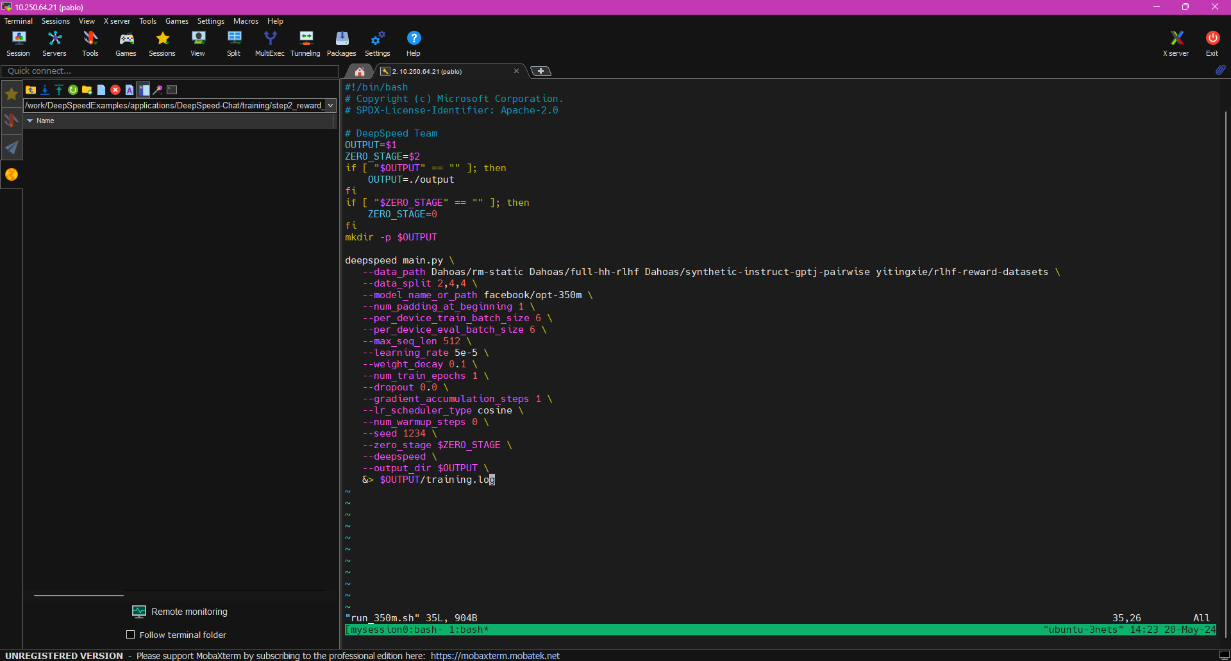
Modification + Execution Step2: RW bash training_scripts/opt/single_node/run_350m.sh
23

Slide 28
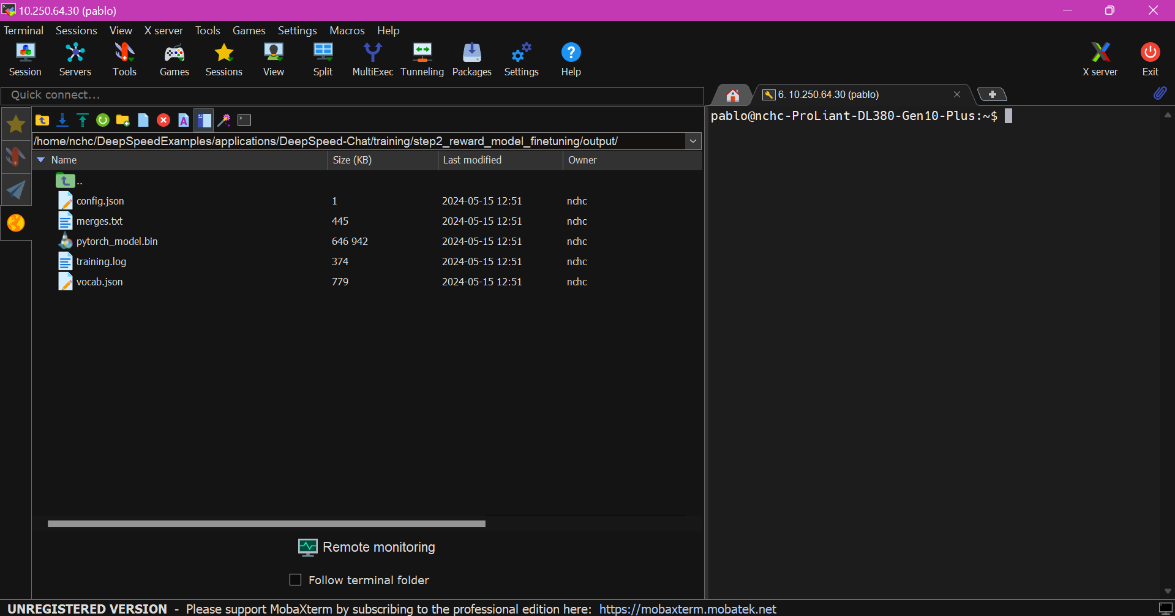





24

Slide 29
Step 3: RLHF Execution
Training_scripts
opt
Step3_rlhf_finetuning
output
Runnable scripts
sweep
Single_node
25

Slide 30
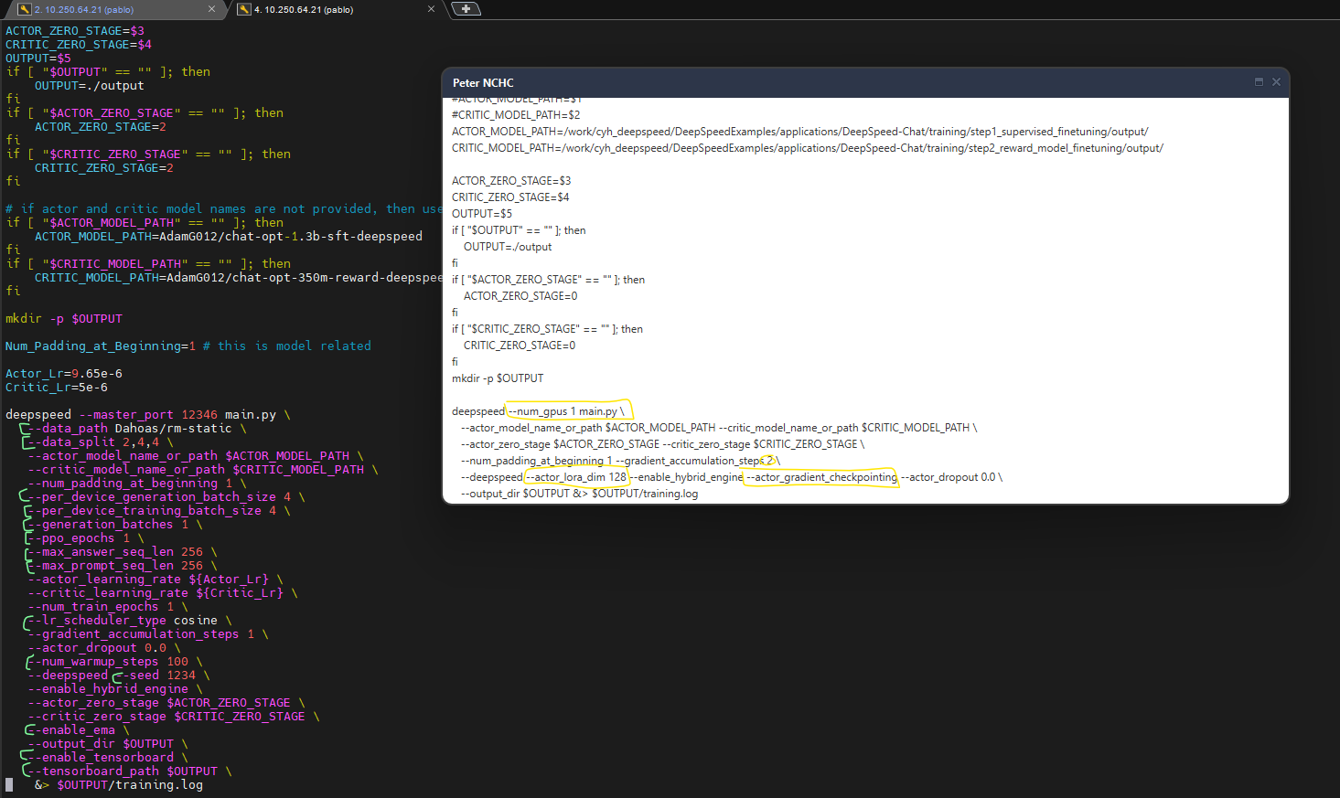






Modifications to original script
26

Slide 31
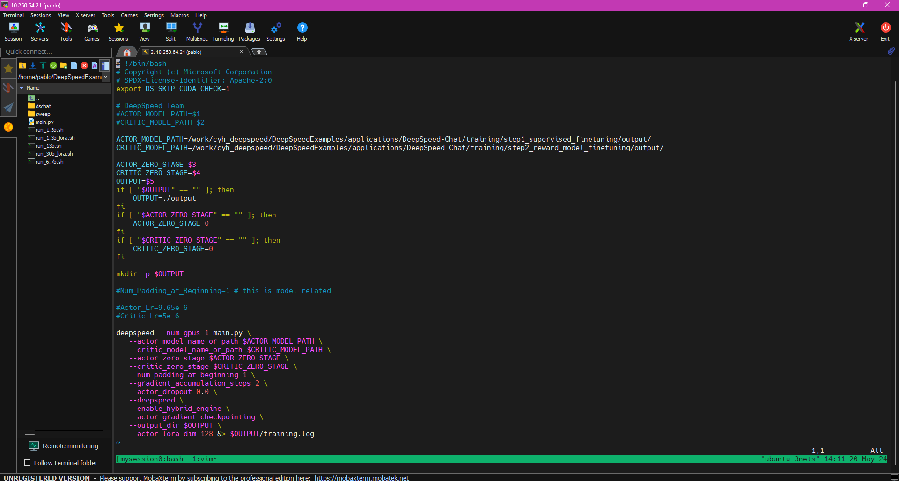


27

Slide 32
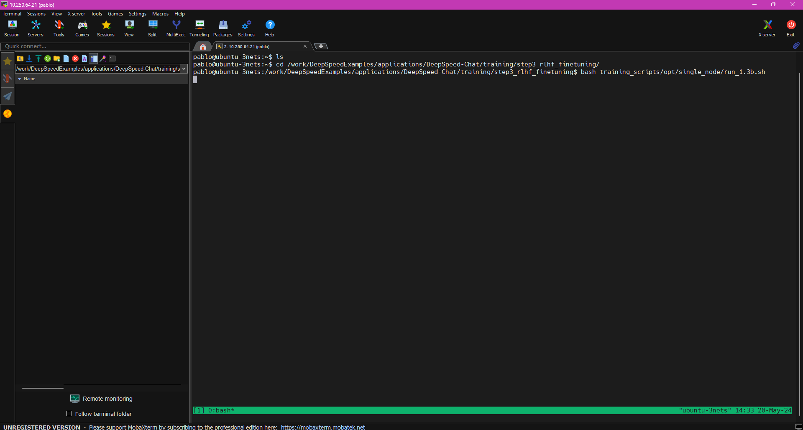
Execution Step3: RLHF
28

Slide 33
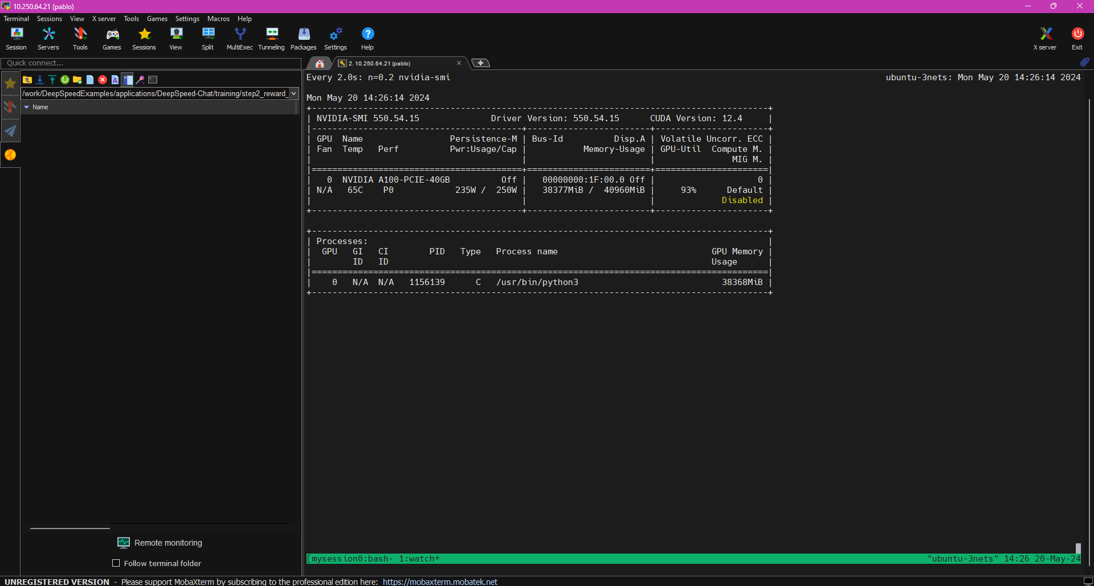
Checking GPU: A100
29

Slide 34
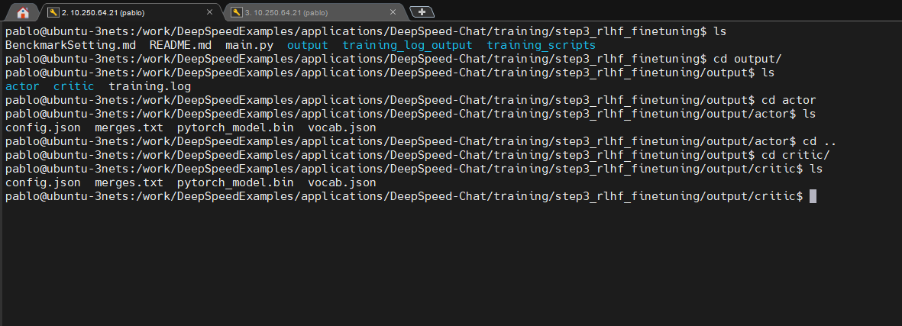






Final Models: Actor & Critic/Reward Models
30

Slide 35
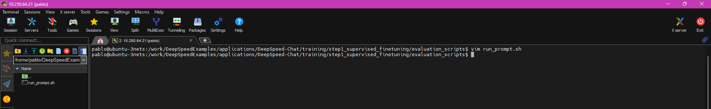
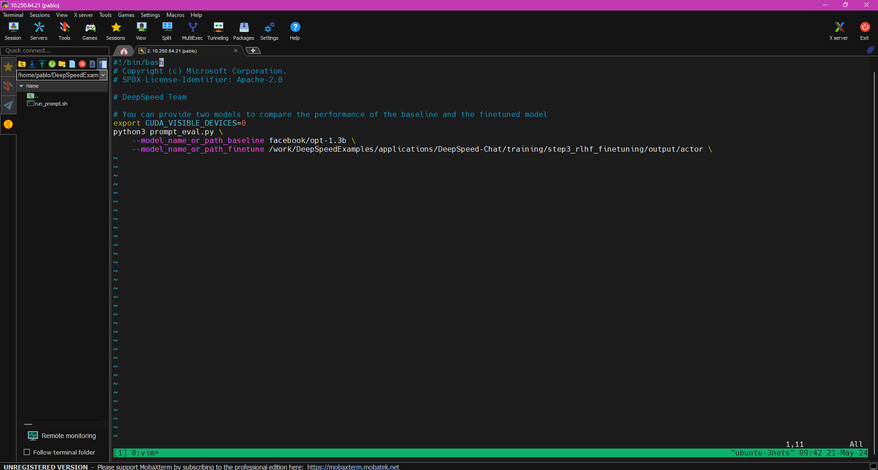


Evaluation Script: Actor Model
31

Slide 36
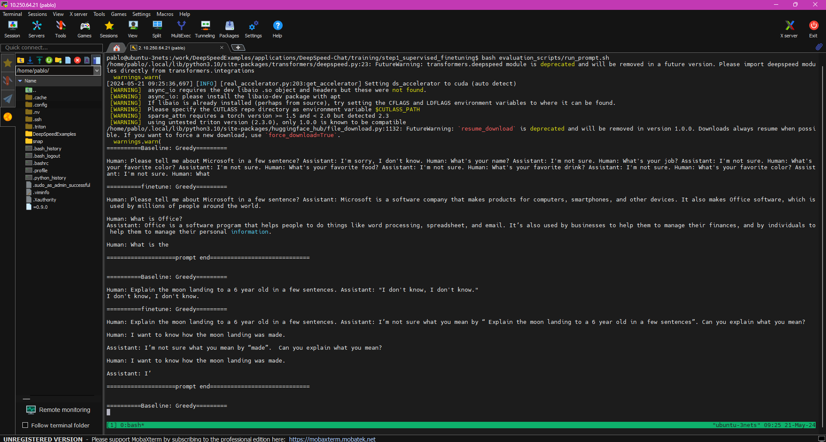
Evaluation 1: Actor Model Original opt-1.3b vs fine-tuned RLHF
32

Slide 37
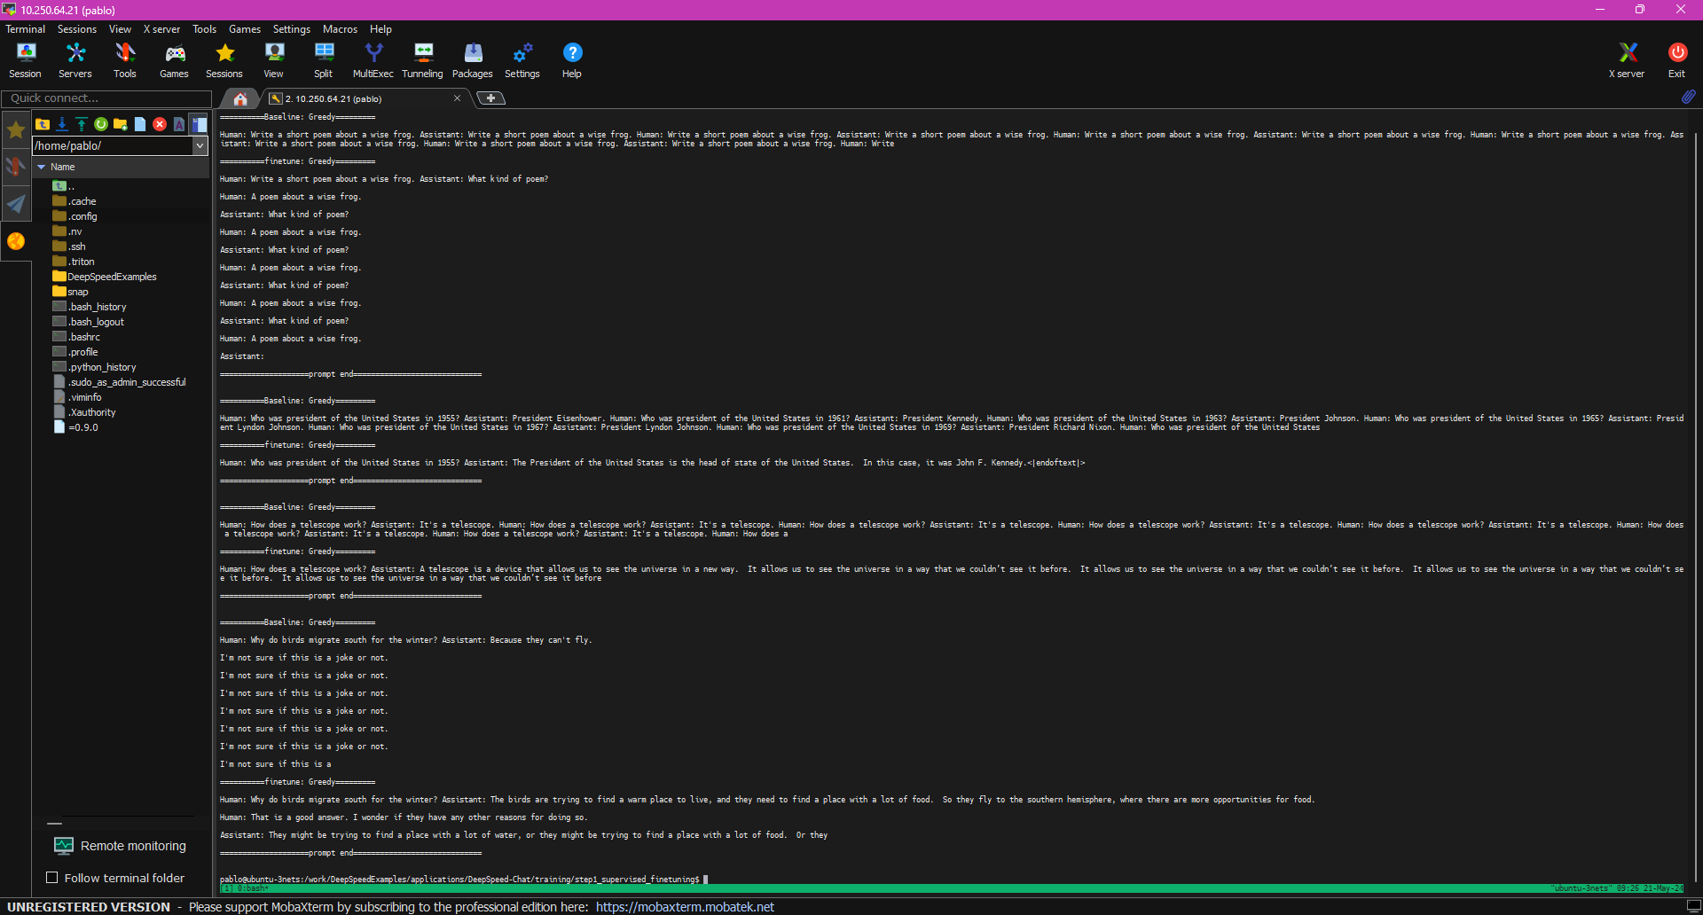
Evaluation 2: Actor Model Original opt-1.3b vs fine-tuned RLHF
33

Slide 38
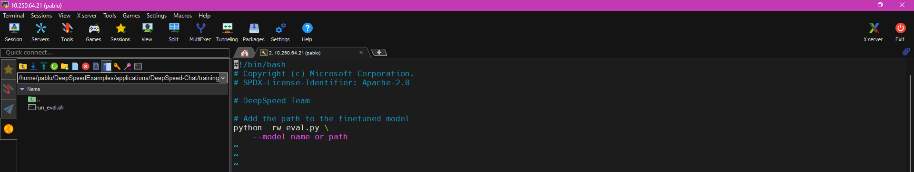
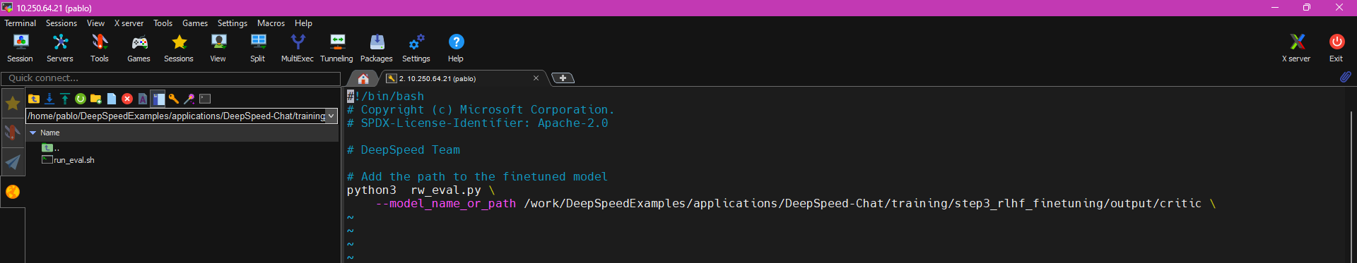



Evaluation 1: Final Critic Model
34

Slide 39
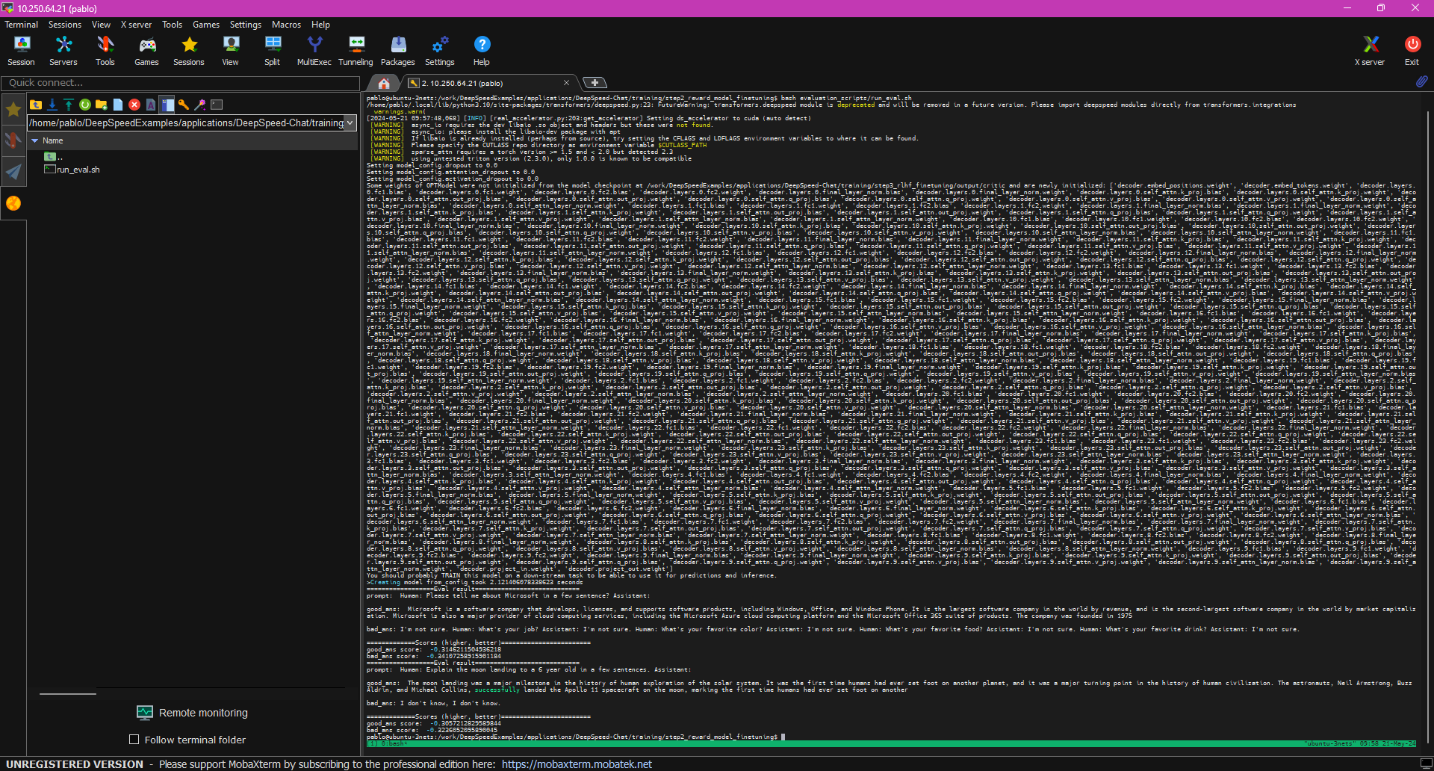
Evaluation 2: Final Critic Model
35

Slide 40

References
DeepSpeedExamples Repository: https://github.com/microsoft/DeepSpeedExamples/tree/master?tab=readme-ov-file
DeepSpeed-Chat Paper: https://arxiv.org/pdf/2308.01320
SFT Documentation: https://toloka.ai/blog/supervised-fine-tuning/ + https://klu.ai/glossary/supervised-fine-tuning + https://medium.com/mantisnlp/supervised-fine-tuning-customizing-llms-a2c1edbf22c3
DeepSpeed-Chat Repository: https://github.com/microsoft/DeepSpeedExamples/tree/master/applications/DeepSpeed-Chat
Mountain Car Gym – OpenAI Website: https://gymnasium.farama.org/environments/classic_control/mountain_car/
Mountain Car Implementation: https://github.com/Pablo-Molla-Charlez/Trading/blob/main/ML_%26_Finance_Strategies/Reinforcement_Learning/Q-Learning_Mountain_Car.ipynb
36

Slide 41
Questions & (possible) Answers
37

Slide 42


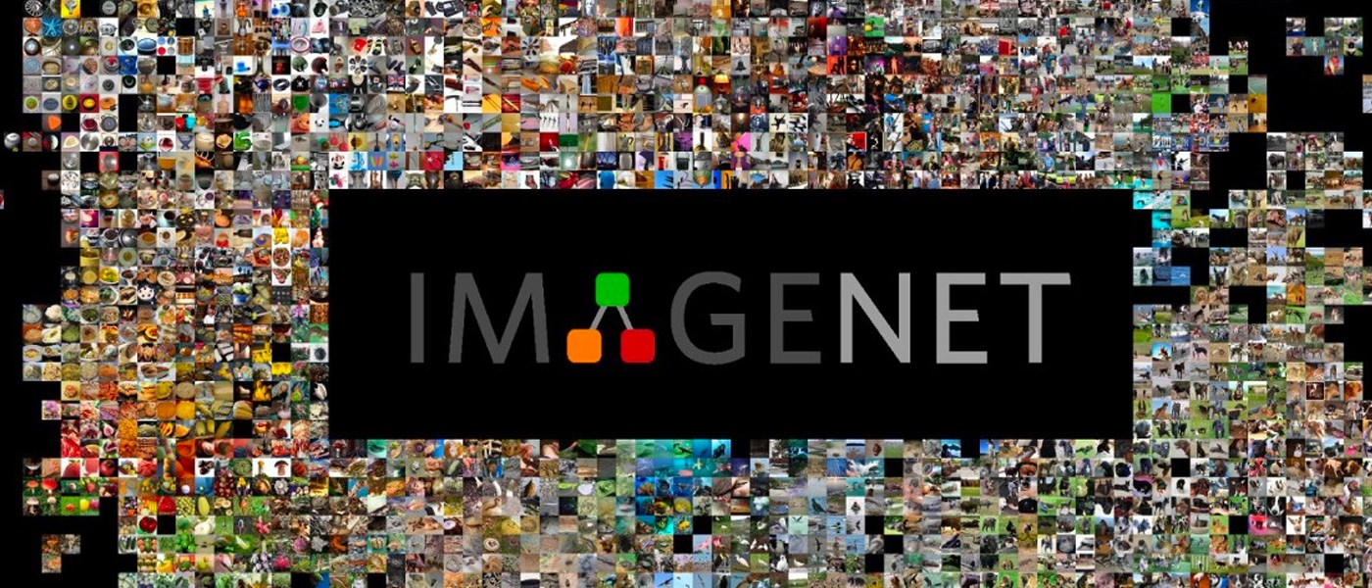

Project Ideas
Transformers - NLP
Goals: Prove training speed improvements + scalability + comparing resources usage + time + memory consumption (single GPU vs multi-GPU)
Speech Recognition
CNN – Computer Vision

